Slide 1
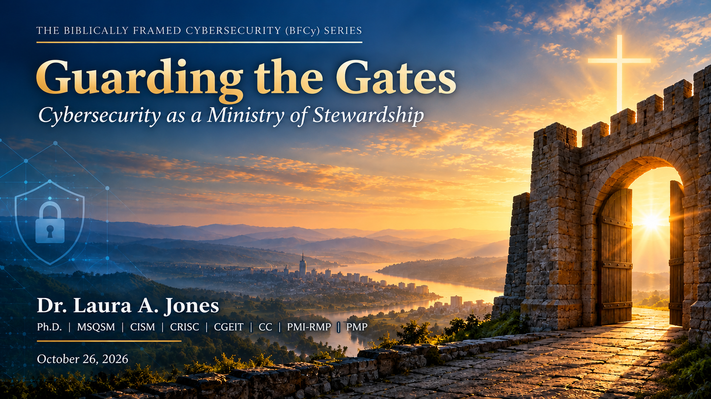

Slide 2

Generations of church leaders have been entrusted
with safeguarding what matters most—
God’s people.
Today, that responsibility extends into the digital world, where much of the information, communication, and ministry leaders care for now lives.
2

Slide 3
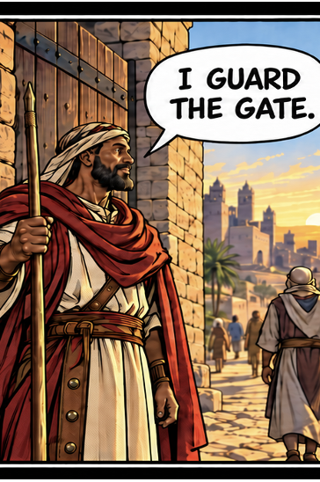
THE OLD LANDSCAPE – UP CLOSE
Access Was Primarily Local, Visible, and Physical
Access was bounded by three physical realities:
PLACE
You had to be on-site.
Entry meant crossing a visible threshold.
PEOPLE
Keys belonged to known people.
Ushers and leaders could see who entered.
TIME
Doors closed at a known time.
Activity happened during known hours.
The perimeter was tangible.
Doors • locks • windows • gates • lighting • cameras
3

Slide 4

THE NEW LANDSCAPE – HYBRID, INTERCONNECTED, AND COMPLEX
Today’s Access Is Internet-Based and Borderless
WHAT IS NOW AT RISK
People
Reputation
Data
Identity
Trust
Financials
Worship Services
WHERE IT NOW LIVES
Member records
Giving platforms
Livestreams
Children’s information
Email/SMS messaging
Payroll
Counseling information
Websites
Social media
Donor information
Cloud and internet services
Care ministry records
4

Slide 5

AN OLD STORY, A NEW MEDIUM
The Serpent Has Gone Digital
How it shows up today:
Deception isn't new
Phishing
Impersonation isn't new
Deepfakes and impersonation
Theft isn't new
Social engineering
Fraudulent requests
Abuse of trust isn't new
Account takeover
Manipulation isn't new
Misinformation
What has changed is the medium.
Insider threat/misuse
“…for we are not ignorant of his devices.” - 2 Corinthians 2:11 (KJV)
5

Slide 6
PUBLICLY REPORTED INCIDENTS
Real Churches, Real Lessons
Four publicly reported incidents, drawn from breach filings, diocesan statements, and ransomware leak-site tracking
Diocese of Salisbury/Church of England
Jul–Aug 2025
New Beginnings Church (NC)
Jan 27, 2026
A cyberattack on the software supplier (Intradev) of background-check provider APCS, c. 31 Jul 2025, exposed DBS applications from Dec 2024–May 2025. Experian monitoring offered; reported to the ICO.
The INC Ransom group claimed the attack on its leak site. No ransom amount disclosed.
Key Takeaway: A vendor’s breach can impact your operations.
Key Takeaway: No congregation is too small to target.
Chapel Hill Presbyterian Church (WA)
Jan 30, 2026
First United Methodist Church, Boerne (TX)
May 11, 2026
Unauthorized external access; about 1,000 individuals notified, with filings in several states. No data types or costs disclosed.
The Interlock group claimed the attack and claimed to have leaked staff, member, and children’s data. No ransom figure disclosed.
Key Takeaway: A small breach can still trigger multistate notices.
Key Takeaway: Stolen data can be weaponized, not just locked from intended use.
Sources: Ransomware.live, DeXpose, UpGuard, Church Times, Diocese of Salisbury, Maine and Massachusetts AG breach filings
6

Slide 7
THE EVIDENCE
Limited Data Does Not Mean Lack of Cyber Risk
Churches do not need to be favored targets to be easy ones
2nd
70%
~85%
The NGO sector ranks second among targets of cybercriminals and hacktivists, behind only IT.
of NGOs have no in-house incident response, analysis, or investigative capability.
of reported U.S. cybercrime losses in 2025 came from cyber-enabled fraud.
Financial losses tied to most cyberattacks on churches remain largely undisclosed.
Limited disclosure may leave an information gap. That doesn't mean the risk is absent.
Sources: OECD (2024), as reported by Infosecurity Magazine; CyberPeace Institute, 2023 Analytical Report; FBI IC3, 2025 Internet Crime Report
7

Slide 8
CULTURE AND RISK
Church and Corporate Culture are Similar
Our greatest strengths can become vulnerabilities
“They’ve shown good character; there is little concern.”
“Let’s give them full access so they’re not held up.”
Excessive trust
Privileged access
“Just send it to me.”
“Hackers are focused elsewhere.”
Informal information handling
False sense of security
Trust without consistent and proper verification can become a vulnerability.
8

Slide 9
WHERE THE MONEY MOVES
Guarding the Money Gate
Business email compromise needs only a trusted name and a willing hand
$20B+
$3B+
22,000+
in reported U.S. cybercrime losses in 2025, a record high.
lost to business email compromise in 2025.
FBI complaints in 2025 referenced artificial intelligence.
Security controls finance leaders may already be using:
Calling back on a known number before fulfilling an unexpected request • Mandating two approvers for wires and ACH • Assessing vendors for risk before using them (e.g., Normal Risk, High Risk, Critical Risk)
Ask your finance team: How do we verify a request to change where money goes?
Source: FBI Internet Crime Complaint Center (IC3), 2025 Internet Crime Report
9

Slide 10





A HUMAN-CENTERED VIEW
What You Are Really Protecting
It’s much less about the servers…the networks…the computer
The congregation
The family
The child
The employee
The guest minister
Making online donations; submitting health-related prayer requests
Receiving counseling; generationally records
Registering for
youth services
Providing banking details for payroll
Sharing personal and travel details
Cybersecurity looks different when we remember that behind every record is a person
10

Slide 11






SCRIPTURE AND CYBER RISK
Biblical Narratives Already Discuss Risks
Temptation and the Fall
Social Engineering and Deception
Guard Your Heart
Jacob Impersonating Esau
Judas as the Moneybag Keeper
Vigilance & Access
Identity theft, impersonation, and scams
Insider threat
Misrepresented Truth
The Tree of Knowledge
Decisions and Actions
Data integrity & misinformation
Principle of least privilege
Audit & Accountability
11

Slide 12
THE CENTERPIECE
Introducing the Biblically Framed Cybersecurity Model
DIVINE COMMAND THEORY
Regulation, Guidance, and Documented Expectation Setting
Temptation and the Fall
Social Engineering and Deception
Decisions and Actions
Audit and Accountability
Biblically Framed
Cybersecurity (BFCy)
Model
Guard Your Heart
Vigilance and Access
The Tree of Knowledge
Principle of Least Privilege (PoLP)
Jacob Impersonating Esau
Identity Theft, Impersonation, and Scams
Misrepresented Truth
Data Integrity and Misinformation
Judas as the Moneybag Keeper
Insider Threat
VIRTUE ETHICS THEORY
Model source: Jones, L. A. (2025). Businesses, 5(4), 60.
Character and Principled Behavior
12

Slide 13







SEVEN STEWARDSHIP PRINCIPLES
Principle Meets Practice
Principle
Effective Stewardship Indicators
Cybersecurity Practice
Stewardship
1 Corinthians 4:2
We know what has been entrusted to us, and we protect it.
Risks are identified, understood, and actively being reduced.
Inventory and risk assess critical assets
Vigilance
1 Peter 5:8
Digital threats are monitored before harm occurs.
Digital doors are watched as carefully as physical ones.
Monitoring and verification against social engineering and impersonation
Integrity
Proverbs 11:3
The information and systems guiding our decisions can be trusted.
Data integrity controls and checks against misinformation
Accountability
Romans 14:12
We know who has access and what they are doing.
Ownership is assigned for the areas that matter most.
Least privilege, access reviews, and audit trails against insider and external threats
Justice
Micah 6:8
We honor our obligations to the people whose information we hold.
If harm occurs, we promptly and appropriately notify them.
Breach notification and privacy obligations to the people affected
Resilience
Proverbs 24:16
The ministry can recover if something significant goes wrong.
The resources needed in a crisis are identified and available.
Backups, continuity plans, and incident response
Shared Responsibility
Nehemiah 3
Roles are understood in protecting the church.
Training and a security-aware church culture
The seven principles extend the published BFCy model into governance practice. Risks named in the right-hand column come from the model (slide 12).
13

Slide 14
BEYOND THE TECHNICAL CONTROLS
Cybersecurity Must Be a Part of Daily Operations
Culture turns security from a technical requirement into a shared habit
Governance
Awareness
Behavior
Community
Culture
Sets direction
Informs
Protects
Reinforces
Sustains
Security isn’t only about technology and physical devices.
Security is amplified when people understand that protecting one another is part of how the church cares for its community.
14

Slide 15
PRINCIPLE MEETS PRACTICE – GOVERNANCE IN ACTION
Five Questions Every Church Leader Should Ask
1
What information has God entrusted to our care?
STEWARDSHIP
2
Who has access to it — and why?
ACCOUNTABILITY
3
What aspects of our church culture enable vulnerability?
SHARED RESPONSIBILITY
4
If our systems were unavailable this Sunday, how would our ministry continue?
RESILIENCE
5
How would we know if someone were impersonating one of our leaders?
VIGILANCE
15

Slide 16
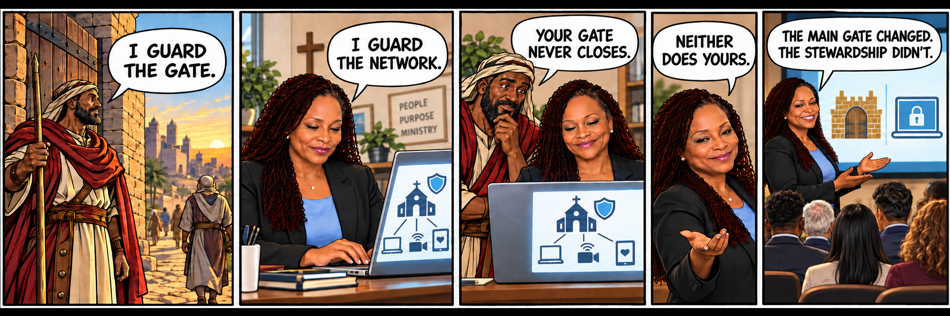
SAME MISSION, CHANGING TIMES
Access Changed – Not the Mission of Stewardship
Vigilance. Protection. Stewardship.
16

Slide 17
How to Get Started
THIS WEEK
Ask the five questions with your leadership team.
OVER THE NEXT MONTH
Name an owner for each
of your digital gates.
THIS QUARTER
Rehearse how ministry continues if systems go down on a Sunday.
“For as the body without the spirit is dead, so faith without works is dead also.” — James 2:26 (KJV)
17

Slide 18
A church organization might not be subject to a regulation stating,
“Every church shall maintain a cybersecurity risk management program...”
But that does not mean it has no legal or contractual obligations for the information entrusted to it.
Examples: breach-notification laws • state privacy laws • PCI DSS v4.0.1 for card giving (contractual) • payroll records
Guarding the Gates isn’t about becoming cybersecurity experts.
It’s about good governance and stewardship.
18

Slide 19
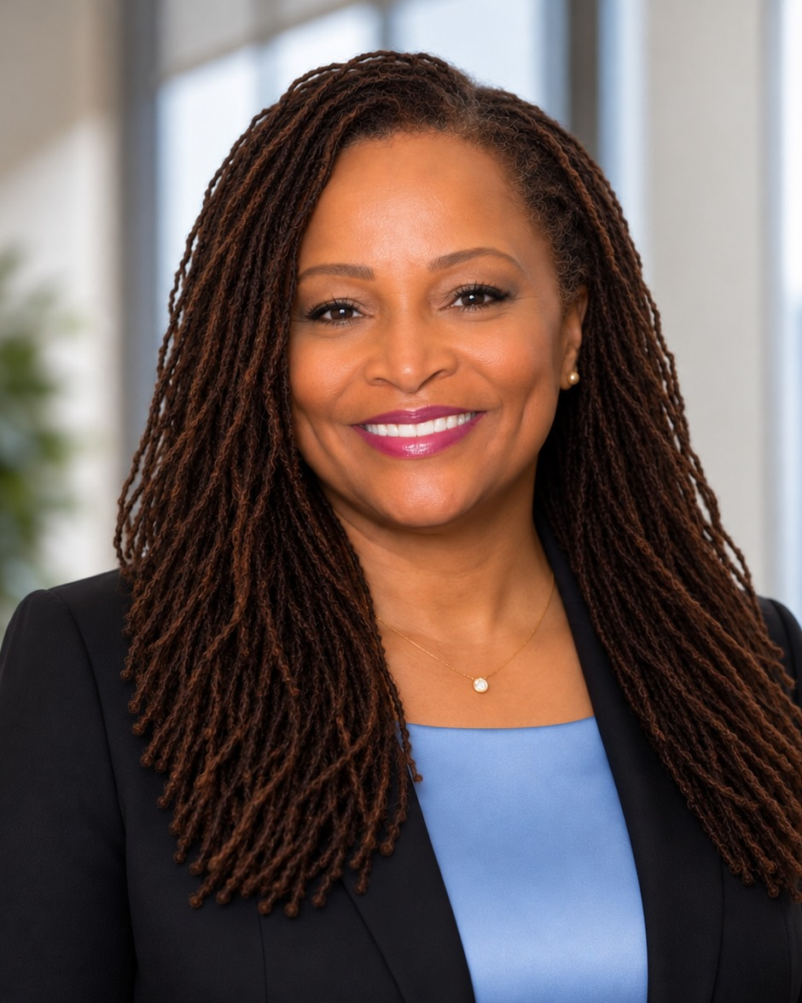
THANK YOU
Dr. Laura A. Jones
Cybersecurity risk and governance leader | Researcher | Educator
21 years
U.S. Army service, retired Master Sergeant
2 Ph.D.s
Cyber Leadership and Product Management
40+
Peer-reviewed publications on cybersecurity, AI, and risk
Executive coach
Carnegie Mellon Chief Risk Officer program
Let’s continue the conversation
DrJones@STEMulateMinds.com
Atlanta, GA

