Slide 1

Biblical Stewardship
God's Money, God's Way
Ultimate Legal Financial Summit
10/26/26
“My thoughts are not your thoughts, neither are your ways My ways,” declares the Lord.”
— Isaiah 55:8
Notes:
Add Pics and Bio of FWB staff members

Slide 2
1
Who Really Owns
The Money?
The Foundation for Everything That Follows
Psalm 24:1

Slide 3
God is the Owner of Everything
1
Psalms 24:1
2
Leviticus 25:23
"The Earth is the Lord's, and everything in it"
"the Land is Mine"
3
Haggai 2:8
4
Psalm 50:10
"the silver and gold are Mine"
"the cattle on a thousand hills are His"

Slide 4
We are Stewards
The definition of a steward is......
One who is entrusted with another's wealth.
God, what do You want me to do with what You have entrusted to me?

Slide 5
God's Part. Our Part.
Since God owns it all and we are managers of His assets.
Every spending decision becomes a spiritual decision.
Your practical faithfulness determines your spiritual maturity.
Money is a tool.
Money is a test.

Slide 6
2
Tithing & Giving
Our Responsibility to God
Proverbs 3:8-9

Slide 7
Giving Back to God
God wants the best and the first of what we give.
“Where your treasure is, there will your heart be also.”
God is concerned about the quality and the quantity of our giving. (Proverbs 3:8-9)
Tithe means tenth.
The tithe should not be a ceiling but a floor.
6

Slide 8
Giving Back to God (Continued)
“Honour the LORD with thy substance…”
Give God the first and the best.
“Where your treasure is, there will your heart be also.”
Giving of your Tithes and Offering is Simply Worship.
The Tithe test and demonstrate our obedience. The offering demonstrates our love.
Tithing is not a substitute for stewardship.
Giving • Saving • Spending • Investing • Protecting • Planning • Leaving a legacy — all are stewardship decisions.
6

Slide 9
3
3
Investing
Growing What God Entrusts
Matthew 25:14–30 • The Parable of the Talents

Slide 10
Jesus Taught in Parables
Matthew 25:14–30
A master entrusted his property to three servants before a journey — each according to his own ability — then returned to settle accounts.
5
2
1
TALENTS
TALENTS
TALENT
Put to work
Put to work
Buried in the ground
Doubled to 10
Doubled to 4
Returned exactly 1
“Well done, good and faithful servant.”
“Well done, good and faithful servant.”
“You wicked and slothful servant.”
God doesn’t condemn multiplication. He condemns unfaithfulness.
THE PRINCIPLE
Every believer is given something to steward — and is expected to put it to work, not bury it out of fear.

Slide 11

The Rule of 72
How do you win a game if you don’t know the rules?
Divide your interest rate into 72 to find the approximate
number of years it takes for money to double!
Do banks or insurance companies have any incentive to teach us this rule?
Years | 3% | 6% | 12%
0
6
12
18
24
30
36
42
48
0
$2,000
$2,000
$2,000
24
$4,000
Who would benefit from learning this rule?
12
36
6
18
30
42
48
$4,000
$8,000
Shouldn’t we have learned this rule in school?
$16,000
$4,000
$8,000
$32,000
This table serves as a demonstration of how
The Rule of 72 concept works from a mathematical standpoint. It is not intended to represent an investment.
The chart uses constant rates of
return, unlike actual investments which will
fluctuate in value. It does not include fees or
taxes, which would lower performance. It is unlikely that an investment would grow 10% or more on a consistent basis.
$64,000
$16,000
$128,000
$256,000
$8,000
$32,000
$512,000
For internal use only. Not to be used with, or distributed to, the public.

Slide 12
Are You Getting Market Rate Returns on Your Investments?
The average yearly return of the S&P 500 over the last 50 years is 11.13%.

Slide 13
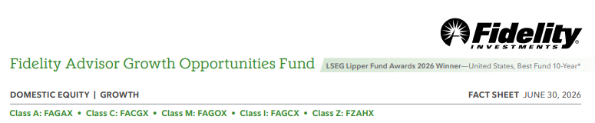
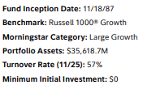
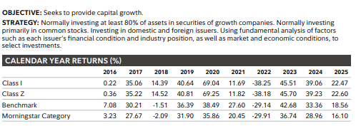

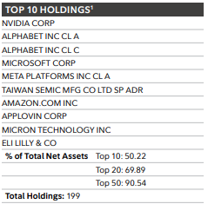
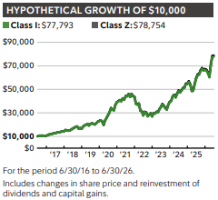



Slide 14
4
4
Life Insurance
Protecting the Family
1 Timothy 5:8

Slide 15
Leaving A Financial Legacy
Scripture doesn't just permit provision for our families — it commands it.
1 Timothy 5:8
Proverbs 13:22
"A good person leaves an inheritance for their children's children, and the wealth is laid up for the just. "
"But if any provide not for his own, and specifically for those of his own house, he hath denied the faith, and is worse than an infidel."
2 Corinthians 12:14
"...for children are not obligated to save up for their parents, but parents for their children."
Protection isn’t about fear of death — it’s about faithfulness to the living.
12

Slide 16

Do you have Personal, Adequate Life Insurance?
Personal means not on your job.
Adequate means 6X – 10X your income.

Slide 17
5
Wills & Trusts
Ordering the Transfer
Proverbs 13:22

Slide 18
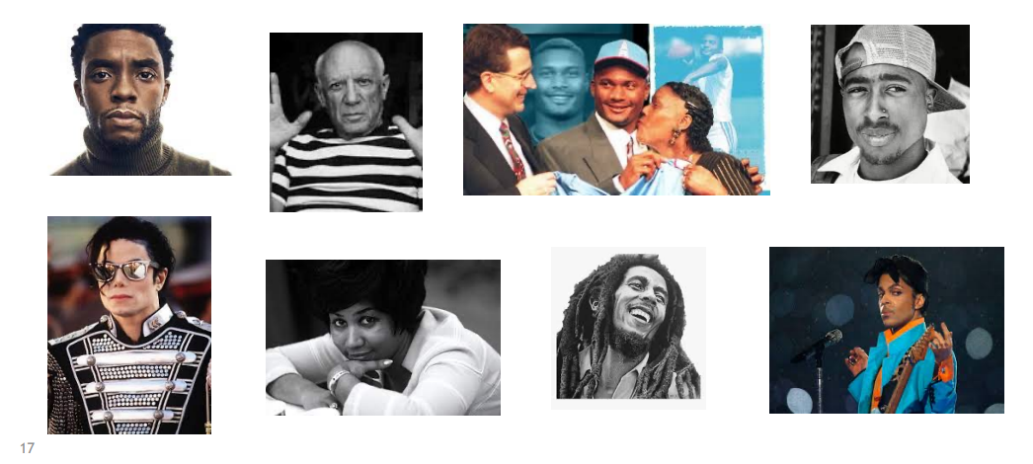
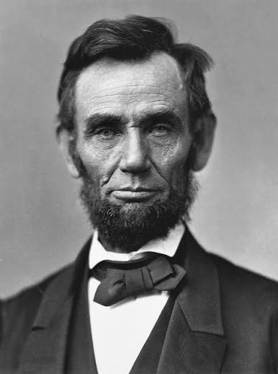
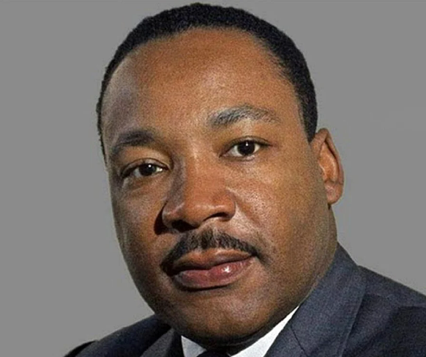
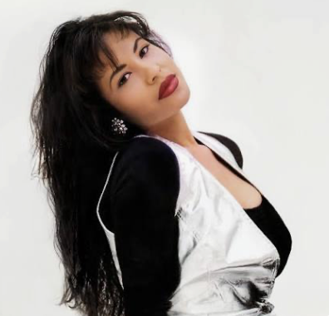
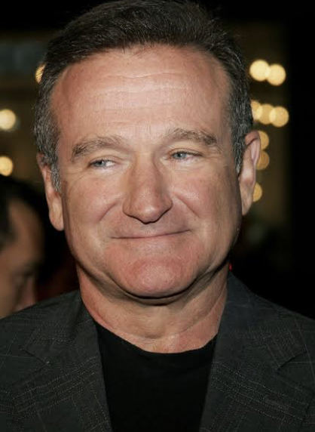
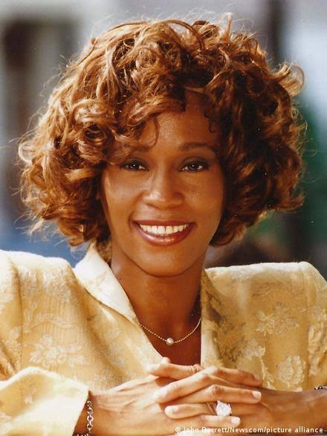


What Do All These Historic People Have In Common?
Notes:
Add Freida C.
Pablo Picasso

Slide 19
They All Died Without A Will or Trust.
Do You Have an Updated Will or Trust?

Slide 20
Leaving a Financial Legacy
3 Reasons You Need A Will
Make sure you have an updated Will.
To determine who will inherit your assets (beneficiary)
To determine who will manage your estate (executor)
To specify the guardian of any children who may still be minors, or who have special needs that will continue into adulthood.

Slide 21
You Can't Take It With You… But You Can Decide Where It Goes.
“A good man leaveth an inheritance to his children’s children…” — Proverbs 13:22
Will vs. Trust
WILL
TRUST
• Instructions after death
• Names beneficiaries
• Can name guardians
• Generally goes through probate
• Greater control
• Can address incapacity
• Manages assets for beneficiaries
• May help avoid probate
15

Slide 22
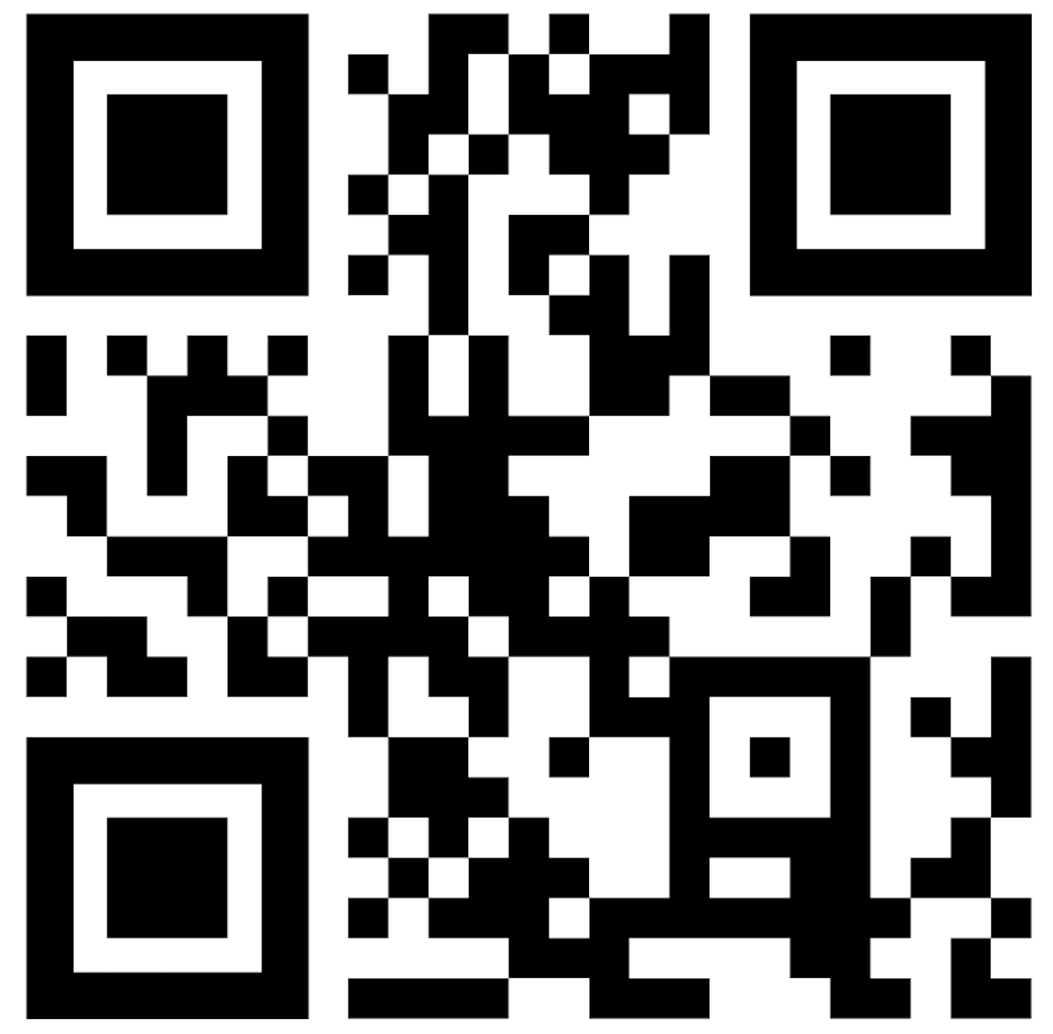
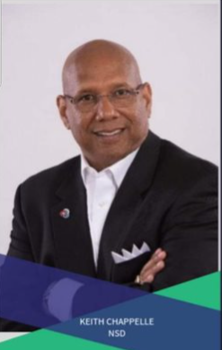
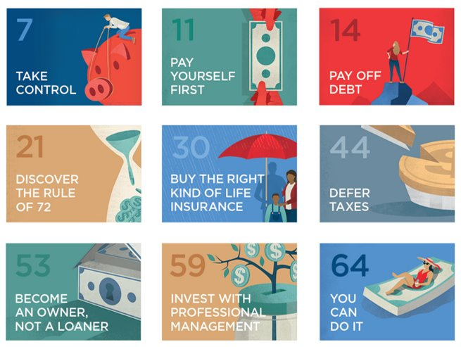
Thank You!!
Complete the short Interest Form to get a Complimentary Copy of our eBook that reveals How Money Works!
Keith Chappelle ​
National Sales Director, NSD​
(817) 608-0600​
Notes:
Add Pics and Bio of FWB staff members

