Slide 1


2026 INTERNAL FRAUD UPDATE:
Current Issues in Anti-Fraud Program Internal Controls
Presented by
STEVE DAWSON CPA, CFE

Slide 2
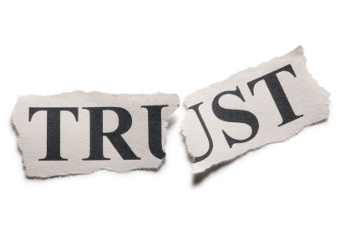
INTERNAL FRAUD, EMBEZZLEMENT, MISAPPROPRIATION, EMPLOYEE THEFT
Fraud committed against the organization by its own officers, directors, or employees
… an attack from within
… a betrayal of trust

Slide 3
FORMAT FOR THIS SESSION
Presentation of the Issue
Fraud Prevention Process Tip
Notes:
.50

Slide 4
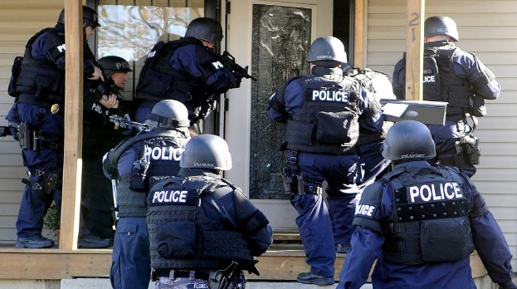
DEBITS AND
CREDITS?
The CEO used company funds to live the good life.
After the SECOND time of being caught, he was finally terminated.
DFG and law enforcement were called in to do the investigation.
Fraud Prevention Process Tip: As much as we want to, do not provide a second chance with fraud.
Notes:
.50

Slide 5
DEBITS AND CREDITS?
On day one of the on-site investigation, we suspected the now former CEO was at his house determining which documents would need to go in the “bonfire”.
We immediately obtained a search warrant from the court and…
Notes:
.50

Slide 6
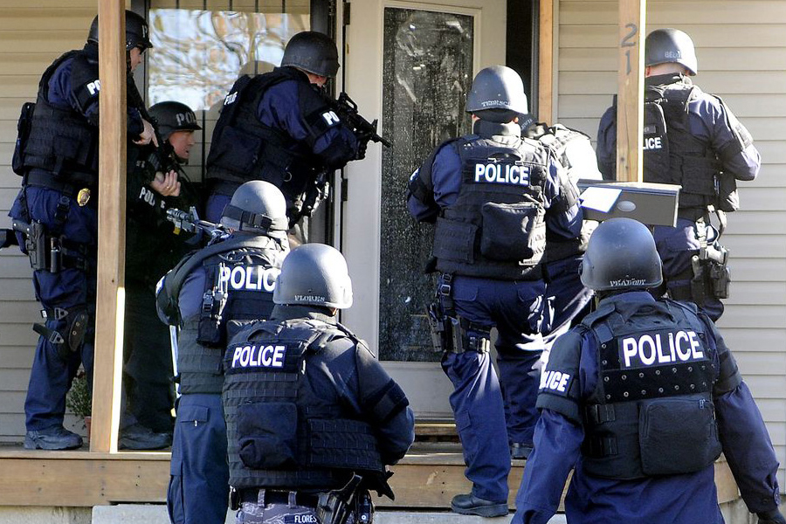
DEBITS AND CREDITS?
Notes:
.50

Slide 7
DEBITS AND CREDITS?
The CEO did not have control over the accounting, but did have control over the accountant…
Or so he THOUGHT.
In reality, the accountant was accumulating documents for every instance of fraud the CEO was committing.
Notes:
.50

Slide 8
FRAUD TRENDS UPDATE
2026 ACFE Report to the Nations

Slide 9
How Fraud is Committed
2026 ACFE Report to the Nations
Asset Misappropriation 90%
Corruption 45%
Financial Statement Fraud 6%
Notes:
.50

Slide 10
How Fraud is Detected
2026 ACFE Report to the Nations
Tips 43%
From Employees 55%
From Vendors/Customers 32%
Fraud Prevention Process Tip: Implement an Anonymous Reporting Mechanism for Employees and Vendors
Notes:
.50

Slide 11
Duration of Fraud Schemes – Median Loss
2026 ACFE Report to the Nations
< 6 Months $ 40,000
19 – 24 Months $168,000
> 60 Months $1,115,000
Notes:
.50

Slide 12
Perpetrator’s Criminal Background
2026 ACFE Report to the Nations
Never Charged or 88%
Convicted
Charged / Not Convicted 6%
Prior Convictions 4%
Notes:
.50

Slide 13
Reasons for Not Referring to Law Enforcement
2026 ACFE Report to the Nations
Internal Discipline 51%
Fear of Bad Publicity 35%
Private Settlement 20%
Too Costly 19%
Lack of Evidence 9%
Fraud Prevention Process Tip: Similar to the “second chance”, internal discipline has not proven successful. The “second chance” also voids any insurance coverage for employee dishonesty.
Bad publicity is worse if the word gets out that you found fraud… and did nothing about it.
Notes:
.50

Slide 14
Recovery of Fraud Losses
2026 ACFE Report to the Nations
Recovered Nothing 56%
Partial Recovery 29%
Recovered All Losses 15%
Fraud Prevention Process Tip: Purchase employee dishonesty insurance coverage. Can also help pay some investigative costs.
Notes:
.50

Slide 15
POLLING QUESTION #1
The number one way that fraud is detected is through:
A. Watching every move everyone makes
B. Tips
C. External audit of financial statements
Notes:
.50

Slide 16
Fraud Awareness Training
2026 ACFE Report to the Nations
  Nonprofit Organizations have the lowest implementation rate of fraud awareness training,
  NPOs that provided fraud awareness training uncovered frauds 2.5x faster than those that did not (9 months vs 2 years),
  Obviously, the median loss increases as the time to detection increases.
  Fraud Prevention Process Tip: Conduct regular fraud awareness training for all employees.
Notes:
.50

Slide 17
Trust… but Verify
  Historically, in all industries nationwide, the
  “Trust… but Verify”
  concept has always existed
  In the organizations represented here today, this level of TRUST is, by nature, exponentially higher.
Notes:
.50

Slide 18
DFG Statistics
WHY do people commit fraud?
Need-based 95%
Greed-based 4.5%
Pathological .5%

Slide 19
DFG Statistics
WHO is committing fraud?
Decent People 95%
Evil People 4.5%
Sick People .5%

Slide 20

CURRENT RECURRING TYPES OF CASES
Notes:
.50

Slide 21
CURRENT RECURRING TYPES OF CASES
  Personal Use of Credit / Debit Cards by Those in High Positions
  Fraud Prevention Process Tips
  Implement a “Usage Policy”
  Card checkout processes
  Required documentation
  If receipt can’t be found, require the employee to reimburse
  No circumstance for reimbursement to employee for business use of personal card
Notes:
.50

Slide 22
CURRENT RECURRING TYPES OF CASES
  Check Forgery for “Extra” Checks / Paychecks to Themselves
  Fraud Prevention Process Tips
  Disbursement Review
  Compare cleared descriptions to system descriptions – disguised payee
  If voluminous, AI can assist
Notes:
.50

Slide 23
CURRENT RECURRING TYPES OF CASES
  Shell Company / Vendor Disbursement Fraud
  Fraud Prevention Process Tips
  New Vendor Establishment Form
  Vendor Information Change Form
  Periodic Master Vendor File Review
  Vendor Disbursement Analytics
Notes:
.50

Slide 24
CURRENT RECURRING TYPES OF CASES
  Online Giving Fraud – Information Takeover
  Fraud Prevention Process Tips
  PCI Compliance
  Assignment of Access Responsibility
Notes:
.50

Slide 25
CURRENT RECURRING TYPES OF CASES
  Nepotism Issues
  Fraud Prevention Process Tips
  Have a Policy
  Follow the Policy
  Authorization for Exceptions
Notes:
.50

Slide 26
CURRENT RECURRING TYPES OF CASES
  Taking advantage of tax-exempt status for personal purchases
  Reimbursement of personal credit card used for business purpose (including sales taxes),
  Fraud Prevention Process Tips
  Mirror the “Usage Policy” Provisions for Credit / Debit Card Purchases
Notes:
.50

Slide 27
CURRENT RECURRING TYPES OF CASES
  Transfers from Designated Funds
To Cover Operating Deficits
To Personal Accounts
  Fraud Prevention Process Tips
  Threshold Limits Should be in Place
  Special Emphasis on Transfer Review
Notes:
.50

Slide 28
CURRENT RECURRING TYPES OF CASES
  High volume of senior leadership fraud =
  “Abuse of Position Fraud”
Notes:
.50

Slide 29

Abuse of Position Fraud
Notes:
.50

Slide 30

Abuse of Position
Legal Definition:
“Fraud perpetrated by a person who occupies a position in which he/she is expected to safeguard, or to not act against, the financial interest of the company”
Notes:
4.00

Slide 31
Abuse of Position
Why?
“Because I can”
Notes:
4.00

Slide 32
Abuse of Position
John Doe, during his tenure as the Chief Executive, with willful Intent, Knowledge, Reckless Conduct and/or Reckless Negligence, used his position to benefit personally through the disbursement of the Organization’s funds for personal purposes. These actions resulted in a direct monetary loss to the Organization.
Notes:
.50

Slide 33
Abuse of Position – Culprit #1
AMAZON.COM
Notes:
.50

Slide 34
Abuse of Position – Culprit #1
AMAZON.COM
When you write a check for an expense, how do you account for it?
When you ACH a payment for an expense, how do you account for it?
When you make a charge on a credit card, how do you account for it?
Notes:
.50

Slide 35
Abuse of Position – Culprit #1
AMAZON.COM
When you purchase on Amazon, how do you account for it?
Notes:
.50

Slide 36
Abuse of Position – Culprit #1
AMAZON.COM
Whose account is it?
What email is used for Login?
What payment methods exist for the account?
What delivery addresses are registered in the account?
Notes:
.50

Slide 37
Abuse of Position – Culprit #1b
PAYPAL.COM
Notes:
.50

Slide 38
Abuse of Position – Culprit #2
Office Depot, Staples, Lowes,
Home Depot, Sam’s, Costco
Do you pay off of “receipts”?
Do you pay off of “statements”?
Do you look at what is being purchased?
Notes:
.50

Slide 39

Abuse of Position – Culprit #3
GIFT CARDS
How do you buy
“loyalty”?
Notes:
.50

Slide 40
Abuse of Position – Culprit #3
GIFT CARDS
Used to Reward Employees
Used to “Pay” Employees
Tracking?
Notes:
.50

Slide 41
Fraud Prevention
“It’s time we get back
to the basics of… accounting”
Notes:
.50

Slide 42
Getting Back to the Basics
Disbursement Process
Amount
Supporting Documentation
Classification (General Ledger Coding)
  Does Documentation Support the Classification?
Proper Business Expense
Does Documentation Support as Business Related?
Notes:
.50

Slide 43
Getting Back to the Basics
Amazon / PayPal
Corporate Account Only
If Purchased Through Personal Account… it’s your loss
Mirror Credit Card Charge Receipt Requirement
No Personal Purchases on Corporate Account Allowed
Notes:
.50

Slide 44
Getting Back to the Basics
Office Depot / Home Depot / Et. Al.
Review Purchases as for Company Purpose
Look for Gift Card Purchases
Who is Doing the Ordering?
Vendor Rep or Company Employee
No Personal Purchases on Corporate Account Allowed
Notes:
.50

Slide 45
Getting Back to the Basics
GIFT CARDS
Authorized Purpose Only
Authorized Amounts Only
Tracking Purchase (as in Inventory) and,
Usage
Notes:
.50

Slide 46
Abuse of Position – Culprit #4
Preference in Purchasing/Contracting
Jane Doe, during her tenure as the Chief Executive, with willful Intent, Knowledge, Reckless Conduct and/or Reckless Negligence, used her position to award purchases / contracts to friends and family companies, bypassing any pre-established approval processes. These actions resulted in a monetary loss to the organization as excessive amounts were paid for these expenses.
Notes:
.50

Slide 47
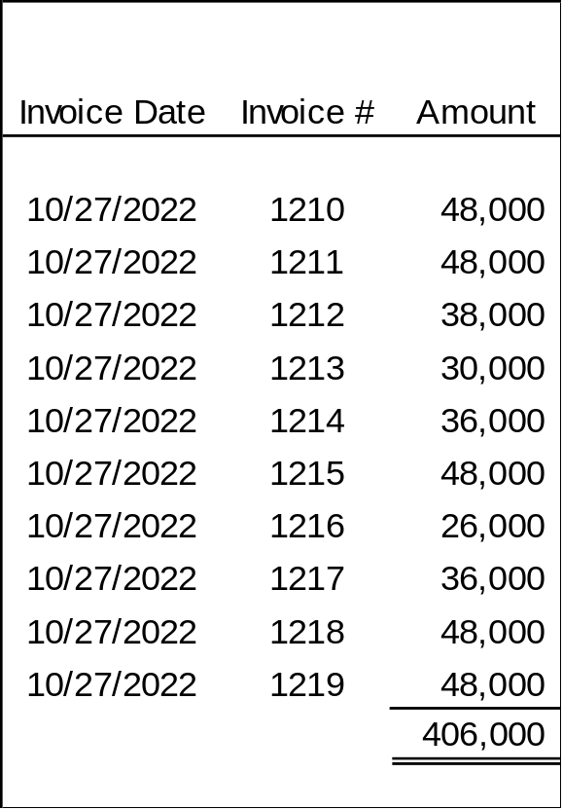
What do you think the approval threshold was?
Abuse of Position – Culprit #4
Notes:
.50

Slide 48
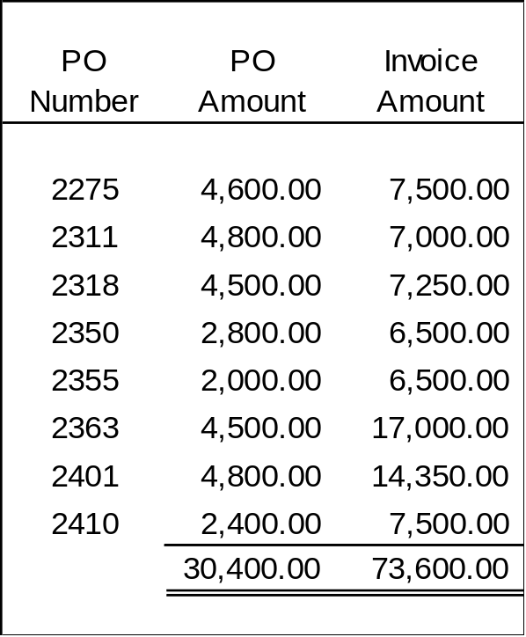
What do you think the approval threshold was?
Abuse of Position – Culprit #4
Notes:
.50

Slide 49
Getting Back to the Basics
Preference in Purchasing / Contracting
Transaction Structuring
Absence of Necessary Contract Documents
Outdated / Altered Documentation in the Contract File
Invoices Without Adequate Supporting Documentation
Notes:
.50

Slide 50
Abuse of Position – Culprit #5 – Nepotism
“A House of Cards”
General Manager
(Father)
Accounting Supervisor
(Son)
CS Supervisor
(Daughter-in-Law)
Engineering Supervisor
Maintenance Subcontractor
(Son)
Notes:
.50

Slide 51
Abuse of Position – Culprit #5 – Nepotism
“A House of Cards”
Engineering Supervisor
Accounting Supervisor
(Son)
CSR Supervisor
(Daughter-in-Law)
Maintenance Subcontractor
(Son)
General Manager
(Father)
Notes:
.50

Slide 52
Getting Back to the Basics
VIOLATIONS OF NEPOTISM
Have a Policy
Follow the Policy
Authorization for Exceptions
Notes:
.50

Slide 53
POLLING QUESTION #2
The best process / internal control to consider today is,
A. Require 2 authorizations for, and review of, all disbursements
B. Rotate the accountant responsibilities to all staff members
C. Get back to the basics
Notes:
.50

Slide 54
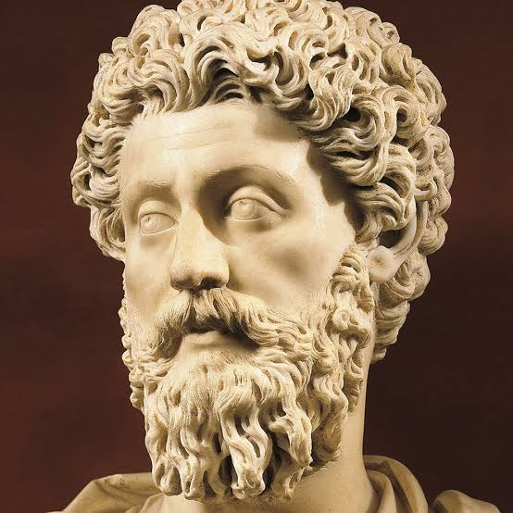
ETHICS?
“What we do now, echoes in eternity”
“Waste no more time arguing about what a good man should be. Be one”
“A MAN SHOULD BE UPRIGHT, NOT KEPT UPRIGHT”
Emperor Marcus Aurelius
Notes:
.50

Slide 55
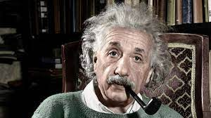
ETHICS?
“Setting an example is not the main means of influencing another, it is the ONLY means” Albert Einstein
Notes:
.50

Slide 56
ETHICS?
What Does Ethics Mean?
“A framework of value-guided principles, such as integrity, empathy, and honesty; used to determine right from wrong, acting as a compass for navigating complex decisions. It involves upholding moral standards, respecting stakeholders, and acting with honor, especially when it is difficult, inconvenient, or when nobody is watching”
Forbes Magazine: Bruce Weinstein, Ph.D.
Notes:
.50

Slide 57
ETHICS?
What Does Ethics Mean… to You?
Well, it depends on what you’re talking about; is it principles or values?
What if I was raised differently than the person next to me?
Who determines what’s right and what’s wrong?
What is right in one place may be wrong in another place.
My inner voice is louder than Steve’s inner voice.
Are you asking about good or bad, fair or unfair, responsible or irresponsible, praiseworthy or blameworthy?
Notes:
.50

Slide 58
ETHICS?
What Does Ethics Mean… to You?
Herein Lies the Problem
Notes:
.50

Slide 59
ETHICS?
What is an Ethical Dilemma?
“A complex decision-making situation where an individual or organization faces a conflict between two or more moral imperatives, where choosing one option results in violating another. It represents a “no-win” scenario, often described as choosing between two “rights” or two equally unacceptable options”
Corporate Finance Institute (2020)
Notes:
.50

Slide 60
ETHICS: PRINCIPLES & VALUES
What’s the difference between an ethical principle and an ethical value?
Principle:
External
Foundational
Somewhat universal guidelines
For determining right and wrong
Mostly “institutional”
Notes:
.50

Slide 61
ETHICS: PRINCIPLES & VALUES
What’s the difference between an ethical principle and
an ethical value?
Principle:
Honesty
Integrity
Fairness
Justice
Respect
Notes:
.50

Slide 62
ETHICS: PRINCIPLES & VALUES
What’s the difference between an ethical principle and an ethical value?
Value:
Internal
Family
Community
Education
Creativity
Social Justice
Notes:
.50

Slide 63
ETHICS: PRINCIPLES & VALUES
What’s the difference between an ethical principle and
an ethical value?
Value:
Making choices and acting in ways that align with an individual’s personal beliefs
Notes:
.50

Slide 64
ETHICS: Test Question
Is it OK to take office supplies home?
How many different thoughts went through your head with this question?
“Am I required to work at home”
“What if I think of a work issue I can handle at home over the weekend”
“What is the company policy”
“These are immaterial items. There are bigger issues to deal with than this”
Notes:
.50

Slide 65
ETHICS: Test Question
Is it OK to take office supplies home for personal use?
A. Yes, they are minor, immaterial items
B. Only with permission
C. No, that is misuse of Company property
The correct answer is C
Notes:
.50

Slide 66
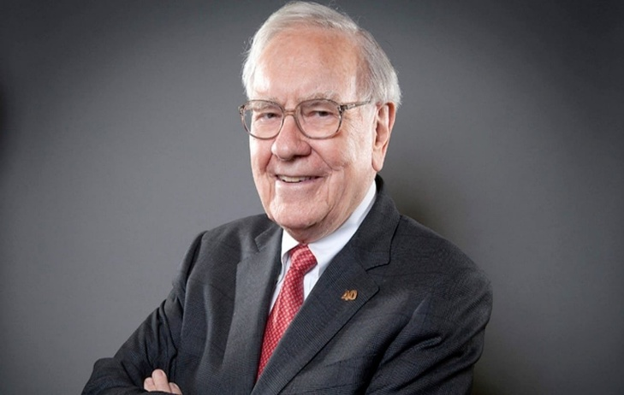
“In looking for people to hire, you look for three qualities: Integrity, Intelligence, and Energy. And if they don’t have the first quality, the other two will kill you”
Warren Buffett
Notes:
.50

Slide 67
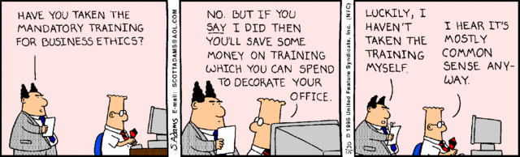
ETHICS TRAINING
Notes:
.50

Slide 68
ETHICS TRAINING
You discover a coworker is falsifying expense reports. What is the most ethical action?
A. Ignore it; it is not your responsibility.
B. Confront the coworker privately but do not report it.
C. Report the behavior through the proper Company channel.
The correct answer is C
Notes:
.50

Slide 69
ETHICS TRAINING
A vendor offers you an expensive gift in exchange for awarding them a contract. This is a conflict of interest because:
A. It is too expensive.
B. It could bias your professional judgment.
C. It is against the law, regardless of intent.
The correct answer is B
Notes:
.50

Slide 70
ETHICS TRAINING
The “Front Page Test”
“Would I be ok if this were on the front page of the newspaper or the lead story on the evening news?”
If unsure, seek advice.
Notes:
.50

Slide 71
ETHICS TRAINING
The “Front Page Test” (signs it might not be good)
The Shame Factor
Its Permanence
Public Disclosure of Sensitive Information
Lack of Proper Context
Notes:
.50

Slide 72
ETHICS TRAINING
Contribute to the Ethical Culture
Set the good example
See something, say something (speak up)
Support others in doing the right thing
Notes:
.50

Slide 73
ETHICS
Ethical Principles and Ethical Values
are TWO Different Things
In fraud prevention, we’ve spent our history on developing the Principles and ignoring the Values
Efforts should focus on adding the training and discussion of ethical values to our training program
Notes:
.50

Slide 74
2026 INTERNAL FRAUD UPDATE:
Current Issues in Anti-Fraud Program Internal Controls
STEVE DAWSON CPA, CFE
Dawson Forensic Analytics, P.L.L.C.
d/b/a DFG FORENSIC ACCOUNTING SERVICES
3331 70TH Street, Suite 300
Lubbock, Texas 79413
806-368-5779
E-mail: steve@dfgfas.com
www.dawsonforensicgroup.com

