Slide 1
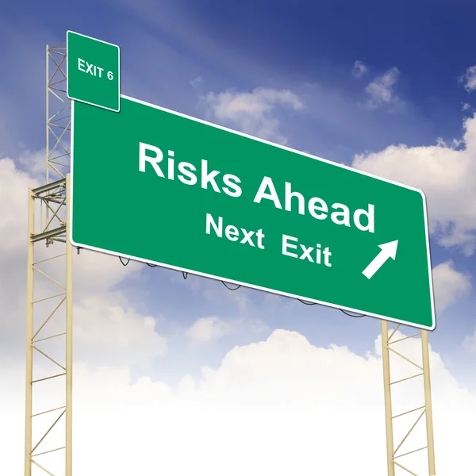

Structure of the Organization
How Do we Determine the ENTIRE Scope of the Operations of the Church?

Slide 2

Structure of the Organization
STRUCTURE OF THE ORGANIZATION
Focusing on the 501(c)(3) organization
Do they have foundations / partner organizations / school that is under the church umbrella of leadership / etc.?
Ask for the org. chart – every time!
  Find out if they are chartering an organization
    This is very important – post Boy Scout litigation.
Notes:
Speaker Notes: Discuss need for organizational chart and post-Boy Scout litigation

Slide 3
Operations of the
Named Insureds
OPERATIONS OF THE
NAMED INSUREDS
Understand ALL of the operations of the insured. (Sometimes this is done by department head. Strategic Assessment)
  School
  Daycare / Mother’s Day Out
  Production Studio / TV
  Children’s programming – full scope
  Special Needs ministry
  Missions
  Life groups / Home groups
  Security
  Autos

Slide 4

Understand Leadership Vision and Direction
UNDERSTAND LEADERSHIP VISION AND DIRECTION

Slide 5
Understanding Leadership Vision and Direction
UNDERSTAND LEADERSHIP VISION AND DIRECTION
What is the direction of the leadership
Ask – they love to share.
Advise if the coverage in place is adequate for their vision. You may need to consult with the carrier / underwriter to see what they can do to accommodate the client or look for another market.
It may need to be peeled off into another entity.
Notes:
Speaker Notes: Security company example

Slide 6
Understanding Leadership Direction
UNDERSTAND LEADERSHIP VISION AND DIRECTION
What are their plans for any changes in facilities or programming in the upcoming years?
Sale of property – are any going to be vacant, etc.
Always ask leading questions so they will elaborate.
Some liability carriers do not have an appetite for the property exposure. Don’t get caught when they call to say they bought a building and need it added.
During the assessment keep in mind you are looking for silos!
Notes:
Speaker Notes: School example regarding assessment and looking for silos

Slide 7
POLLING QUESTION
WHY IS IT IMPORTANT TO UNDERSTAND THE DIRECTION LEADERSHIP IS GOING?

Slide 8

Help Organization
Identify Who Are “We”
Help Organization
Identify Who Are “We”

Slide 9
Building Usage /
Third-Party Liability
BUILDING USAGE /
THIRD-PARTY LIABILITY
Let’s start with Building Usage to help us identify the full scope of liability.
We don’t know the exposures of the entire organization until we understand how they are using their buildings.
The church does not know who they are until they wrap their arms around this.

Slide 10
Building Usage /
Third-Party Liability
Building Usage /
Third-Party Liability
Boy Scouts Settlement
82,000 claims
Scouts filed for Bankruptcy – May 2020
Settlement in 2021 did not release the third parties who chartered the organization
Resolution with BSA paid $850MM into fund
Charter Organizations – July 2021 third parties were not released
Settlement over $2Billion now as third parties have added to settlement fund

Slide 11
BUILDING USAGE / THIRD PARTY
Third-Party Liability – an organization is held responsible for the harmful actions of another.
  This is important as it relates to use of facilities.
  Example: child abuse on premises. You will normally see not only the organization conducting the programming sued, but they will bring in any third-party they can and those parties will have to buy their way out.

Slide 12
BUILDING USAGE / THIRD-PARTY LIABILITY
This is not limited to chartering; it is much larger in scope.
Important to understand the following creates third-party liability also:
  Gym Usage
  Soccer Fields
  Building Usage
  Other organizations using facilities
  Let’s visit on this – What outside organizations use your facilities?

Slide 13
BUILDING USAGE / THIRD-PARTY LIABILITY
Who else is watching the risk of third-party liability?
  Insurance carriers are taking note and increasing their underwriting criteria around building usage.
  Narrower guidelines
  Wanting Additional Insured status captured
  Reviewing who uses the facilities
  Difficult to find coverage for churches who are a chartering organization of Boy Scouts

Slide 14
BUILDING USAGE / THIRD-PARTY LIABILITY
Who are “WE”?
  Who is using the facilities?
  Get a comprehensive listing.
  Ask all leadership to let you know. Most of my churches do not have any idea of all the building usage that is creating third-party liability. Centralize this. Eliminate silos.
  What is your process? Let’s not wait for a crisis. – Claims example: Hawaii Church

Slide 15
BUILDING USAGE / THIRD PARTY
Gather information
Develop a plan
  Create a streamlined process
    Identify who is using the facilities.
    Have them fill out the Facility Use Agreement
    Review controls if children are included in the program – see exhibit in the back)
    Are these like-minded organizations – consistent with mission?
    You can use a survey or qualify them for facility usage. Flow chart Example:
Notes:
Speaker Notes: review Facility Use Agreement and necessary controls regarding children

Slide 16
FACILITY USE AGREEMENT
  Permitted Users / Qualified Building Usage
  Process / Framework
    Qualify Potential Permitted Users
    Review sample
    Also need to have Facility Policy that outlines Belief Statement and is incorporated into Facility Use Agreement
Notes:
Speaker Notes: Review Facility Use Agreement

Slide 17
FACILITY USE AGREEMENT
Every Permitted / Qualified User Signs Facility Usage Form
  Access areas / Dates / Details of usage
  Certifies Child Protection Efforts of Qualified User related to Sexual Abuse
  Outlines insurance requirements
    Identifies levels of coverage
    Captures Additional Insured status
  (Extends “as required by written contract”)

Slide 18
FACILITY USE AGREEMENT
There is a balance regarding what is required and the extent of the screening process.
  Main concern is children’s programs
  What is the screening process?
  Are they allowing registered offenders on campus and as volunteers? Impact to church campus activities, etc.

Slide 19
ABC CHURCH BUILDING USAGE
ALL of the building usage that is occurring at sites that are NOT insured now becomes the “WE” of the church. That is important information!
Each time I do this exercise with a client, they are SHOCKED at who is utilizing the church buildings.

Slide 20
POLLING QUESTION
WHY IS IT IMPORANT TO UNDERSTAND WHAT IS NOT INSURED IN YOUR OPERATIONS?

Slide 21
QUALIFYING FOR BUILDING USAGE
Recommend a Central Controller position to monitor building usage. Someone who is trained.
Criteria for usage approval needs to be clear
  Does this line up with mission? If green light then:
  Insured? Yes or No
  Are you a 501(c)(3) Organization? Yes or No
  Activities involving Children?
  Sports?
  Camps?
Notes:
Speaker Notes: Central Controller position

Slide 22
ABC CHURCH BUILDING USAGE
  Does this building usage align with the mission of the church?
    The church needs to evaluate this! It may be the first time someone put this in front of them.
  Let’s flow chart this out (see next slide)
  Insured vs Not Insured

Slide 23
BUILDING USAGE FLOW CHART
Controller Receives Request
Qualification Process
Insured
Uninsured

Slide 24
RESULTS
The client now knows the true scope of their exposure.
They can now make informed decisions.
The insurance company/agent/risk manager now understand the full scope of who they are insuring.
Implement processes to qualify the third-party for building usage.
Notes:
Speaker notes: Discuss how third-party building usage ties into risk culture of the organization.

Slide 25
POLLING QUESTION
WHAT IS A BENEFIT OF UNDERSTANDING THE FULL SCOPE OF THE CHURCH OPERATIONS?

