Slide 1


Maximizing Donor Engagement Through AI
Discover how nonprofits can leverage artificial intelligence to transform their donor relationships and drive sustainable growth.
Tracy V. Allen, Ph.D., PMP, LSSGB, MLC

Slide 2

Tracy V. Allen, Ph.D., PMP, LSSGB, MLC
Turning Mission Into Money—Now Powered by AI 25+ years driving results for mission-driven organizations: → $55M+ in grant funding secured → $15M in revenue generated → $5M in government contracts won Amazon Bestselling Author | 7 Books | 15,000+ Students Trained | 3 Successful Businesses Launched Now leveraging AI to help nonprofits and social enterprises maximize donor engagement, amplify impact, attract funding, and scale sustainably—without losing your mission.

Slide 3
Today's Journey
Understanding AI basics for nonprofits
Current donor engagement challenges
AI tools and solutions (beginner-friendly)
Advanced strategies and automation
Implementation roadmap
Ethics and best practices

Slide 4
The Donor Engagement Crisis
Donor retention rates averaging 43% (down from 45%)
Donor retention rates have been declining, posing a challenge for nonprofits to maintain a stable donor base.
70% of first-time donors never give again
A large portion of first-time donors do not continue their support, making it difficult to build long-term relationships.
Manual processes consuming 30+ hours/week
Inefficient manual processes for donor engagement are consuming a significant amount of staff time and resources.
Inability to personalize at scale
Nonprofits struggle to provide personalized donor experiences due to limited resources and technology capabilities.
Limited resources for donor research
Nonprofits often lack the time and tools to thoroughly research and understand their donor base, hindering their ability to engage effectively.
Missed opportunities for engagement
Nonprofits may miss out on valuable opportunities to connect with donors and deepen relationships due to the challenges they face.

Slide 5
What is AI? (The Basics)
AI Definition:
Machine Learning:
Generative AI:
Technology that simulates human intelligence
Systems that learn from data patterns
Creates content (text, images, analysis)
Natural Language Processing:
For Nonprofits:
Understands human language
AI = Your tireless assistant that works 24/7

Slide 6


AI Myths vs. Reality
Percentage of Nonprofit Professionals
MYTH
REALITY
"Too expensive for us"
Many tools free or <$50/month
"Replaces human staff"
Enhances staff capabilities
"Too complicated"
User-friendly interfaces exist
"Only for big organizations"
Scales to any size
"Will lose the personal touch
Enables MORE personalization

Slide 7












Poll:
A) AI tools typically cost $500+ per month, making them inaccessible for small nonprofits
B) AI replaces the need for human staff in donor relations
Which statement about AI for nonprofits is TRUE?
D) AI is too complicated for organizations without IT departments
C) Many AI tools are available for free or under $50/month

Slide 8




The AI Donor Engagement Framework
Pillar 1 - IDENTIFY
Pillar 2 - PERSONALIZE
Pillar 3 - ENGAGE
Pillar 4 - RETAIN
Find and qualify prospective donors using AI-powered research and predictive analytics
Tailor communications at scale through AI-generated content and smart segmentation
Deepen donor relationships strategically using AI-powered chatbots, predictive engagement timing, and conversational AI
Predict and prevent donor attrition through AI-driven churn prediction and lifetime value optimization

Slide 9
Pillar 1 - IDENTIFY (Beginner)
AI-Powered Prospect Research
Tools to Start Today:
ChatGPT/Claude
Research donor backgrounds, company info
LinkedIn Sales Navigator
AI-powered prospect identification
iWave/DonorSearch
Wealth screening with AI insights
Quick Win
Spend 10 minutes with ChatGPT researching your top 10 prospects' companies and interests

Slide 10

Pillar 1 - IDENTIFY (Advanced)
Predictive Analytics for Donor Discovery
Lookalike modeling: Find donors similar to your best supporters
Propensity scoring: Rank prospects by likelihood to give
Major gift prediction: Identify upgrade candidates
Planned giving indicators: Spot legacy gift prospects
Tools: Gravyty, Fundraise Up, Blackbaud AI

Slide 11
Pillar 2 - PERSONALIZE (Beginner)
Content Creation at Scale. Use AI to Generate:
Personalized email subject lines
Donor acknowledgment letters
Social media content
tailored to donor interests
60% higher open rates
with specific impact mentions
Newsletter articles
Thank you video scripts
Demo: "Write a thank you email to Sarah, a teacher who donated $250 to our literacy program..."
highlighting relevant programs
Demo: "Write a thank you email to Sarah, a teacher who donated $250 to our literacy program..."

Slide 12






Pillar 2 - PERSONALIZE (Intermediate)
Smart Segmentation & Messaging. AI-Driven Segmentation:
1
Behavioral patterns (giving frequency, amounts, timing)
2
Interest categories (programs, causes, events)
3
Communication preferences (email, text, phone)
4
Engagement levels (hot, warm, cold)

Slide 13
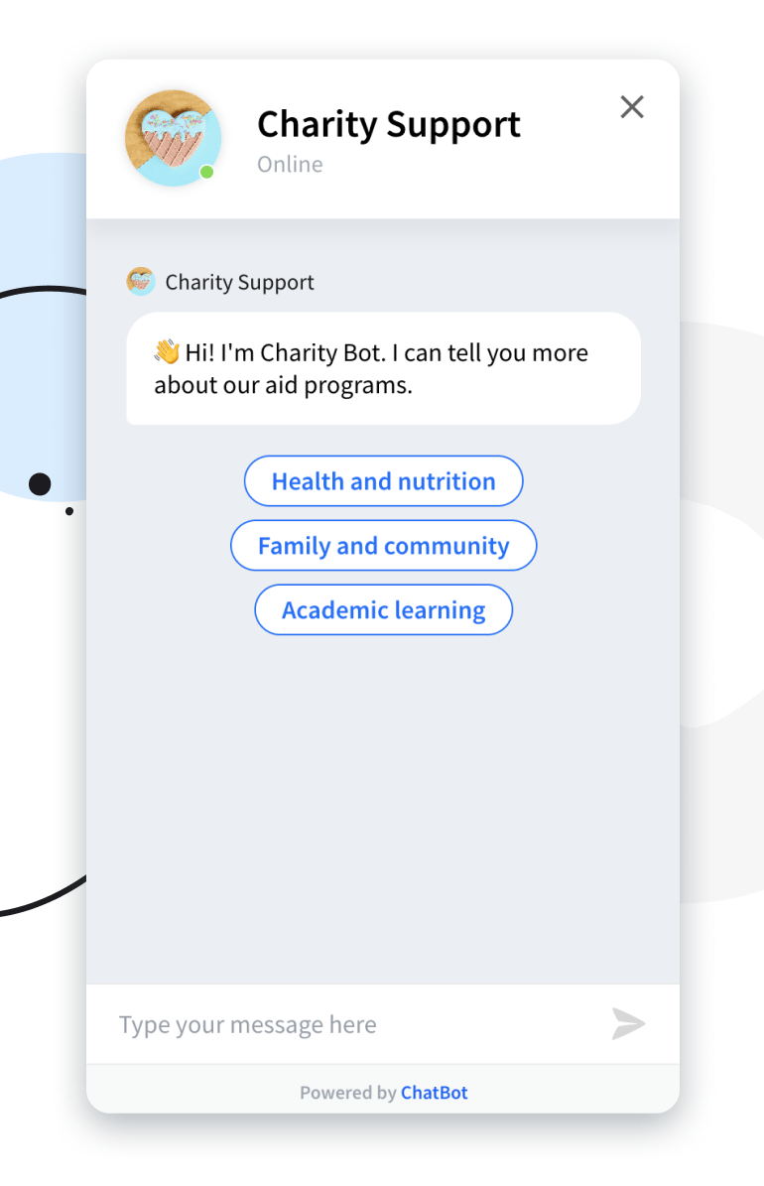
Pillar 3 - ENGAGE (Beginner)
Chatbots & Automated Responses 24/7 Donor Support:
Answer FAQs instantly (donation process, tax receipts, programs)
Qualify leads through conversation
Schedule meetings with gift officers
Provide impact updates on demand
Platforms: ManyChat, Tidio, Drift (Nonprofit plans available)
ROI: One nonprofit gained 340 new donors through chatbot conversations

Slide 14
Pillar 3 - ENGAGE (Intermediate)
Best day/time to reach each donor based on AI analysis
85%
80%
75%
70%
65%
Email Open Rates
Donation Conversion Rates
Upgrade Likelihood
Event RSVP Rates
Lapsed Donor Reactivation

Slide 15
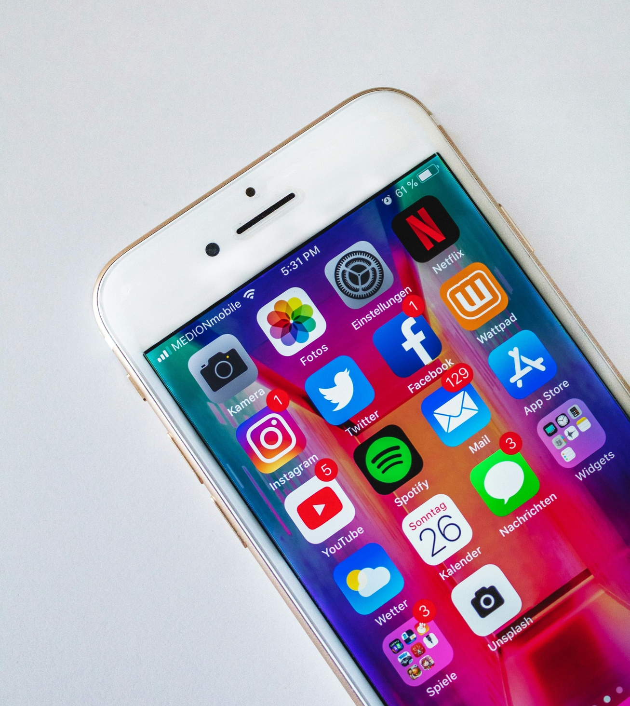
AI Determines:
Best day/time to reach each donor
Optimal email send times (by individual)
When donors are most likely to upgrade
Ideal event invitation timing
Re-engagement windows for lapsed donors
Pillar 3 - ENGAGE (Intermediate)
Predictive Engagement Timing
TOOLS
SALESFORCE EINSTEIN,
HUBSPOT AI
MAILCHIMP SMART SEND

Slide 16
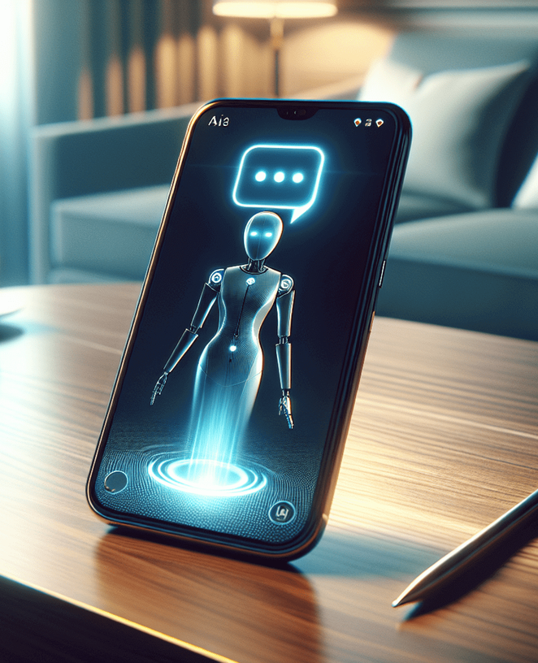



Pillar 3 - ENGAGE (Advanced)
Conversational AI & Voice Technology | Cutting-Edge Applications:
AI-Powered Phone Calls
Voice Sentiment Analysis
Real-Time Call Coaching
Automated Summaries
AI-driven phone calls for donor stewardship
Voice analysis to gauge donor sentiment
Real-time call coaching for gift officers
Automated meeting summaries and follow-ups

Slide 17

Poll
According to the AI Donor Engagement Framework, which is NOT one of the four pillars?
A) Identify - Find and qualify prospects
B) Personalize - Tailor communications at scale
C) Monetize - Increase donation amounts
D) Retain - Predict and prevent donor attrition

Slide 18

Pillar 4 - RETAIN (Intermediate)
Churn Prediction & Prevention
Early Warning System:
1. Identify at-risk donors before they lapse
2. Detect declining engagement patterns
3. Flag donors with negative sentiment
4. Predict likelihood of renewal.
5. Automate intervention campaigns
Action: Create "save" campaigns triggered by AI alerts

Slide 19





Pillar 4 - RETAIN (Advanced)
Lifetime Value Optimization | Maximize Each Relationship:
1
Calculate donor lifetime value (LTV)
2
Predict upgrade potential and timing
3
Optimize ask amounts using AI
4
Determine ideal cultivation pathways
5
Portfolio assignment automation

Slide 20
Essential AI Tools Stack
Your Starter Kit (Budget-Friendly) | Free/Low-Cost Tier:
Free/Low-Cost Tier
Growth Tier ($50-200/month)
ChatGPT/Claude Free ($0-20/month) - Content & research
Canva AI (Free-$13/month) - Graphics
Gmail AI/Outlook Copilot (Included) - Email assistance
Google Analytics (Free) - Website insights
Donor management with AI (Bloomerang, Givebutter)
Email automation (Mailchimp, Constant Contact)
Social media scheduler with AI (Buffer, Hootsuite)

Slide 21



Building Your AI Strategy
90-Day Implementation Roadmap
Month 1: Foundation
Audit current donor data quality, Select 2-3 beginner AI tools, Train 1 staff champion, Start with email personalization
Month 3: Optimization
Month 2: Expansion
Roll out churn prediction, Launch advanced segmentation, Automate donor research, Scale what works
Implement chatbot, Add predictive analytics, Create AI-generated content library, Measure baseline metrics

Slide 22
Data: The Fuel for AI
Garbage In = Garbage Out | Critical Data Hygiene:
Clean, deduplicated contact records
Ensure your donor data is accurate and up-to-date to power effective AI applications.
Consistent data entry standards
Establish clear guidelines for how donor information is captured and maintained.
Regular database maintenance
Regularly review and update your donor database to keep it organized and reliable.
Privacy compliance (GDPR, CCPA)
Adhere to data privacy regulations to build trust and protect your donors' information.
Donor preference tracking
Record and honor your donors' communication preferences to provide a personalized experience.

Slide 23
Ethics & Best Practices
Responsible AI Use in Fundraising | Non-Negotiables:
Transparency
Human Oversight
Privacy
Disclose AI use when appropriate
Never fully automate major donor relationships
Secure donor data, honor preferences
Authenticity
Equity
Testing
Use AI to enhance, not replace, genuine connection
Ensure AI doesn't perpetuate bias
Always review AI outputs before sending

Slide 24
Common Pitfalls to Avoid
Implementing too many tools at once
Trying to roll out multiple AI tools simultaneously can overwhelm staff and lead to inconsistent results. Start small and scale gradually.
Not training staff properly
Ensure your team is well-versed in the capabilities and use cases of the AI tools you implement. Provide ongoing training and support.
Ignoring data quality first
Without clean, well-structured donor data, AI will not be able to deliver accurate insights or personalized engagement. Address data hygiene before deploying AI.
Over-automating communication
While AI can enhance and scale personalization, overdoing automation can come across as impersonal. Maintain the human touch in key donor relationships.
Forgetting the human touch
AI should complement, not replace, genuine human interaction. Ensure your staff remains actively engaged with donors, even as you leverage AI capabilities.
No measurement strategy
Failing to establish baseline metrics and track the impact of AI initiatives will make it difficult to justify continued investment and optimization.
Failing to get leadership buy-in
Without support and resources from executive leadership, AI implementation efforts are likely to stall or fail. Secure buy-in early on.

Slide 25


ROI Metrics That Matter
Measuring AI Impact | Track These KPIs:
Metric
Target Improvement
Donor retention rate
+10-15%
Average gift size
+15-25%
Cost per dollar raised
-20-30%
Staff time saved
10-15 hours/week
Email open/click rates
+30-50%
Prospect-to-donor conversion
+25%
Donor satisfaction scores
Increase
*Impctrs Management Group

Slide 26
Poll
What is the most critical foundation for successful AI implementation in donor engagement?
A) Purchasing the most expensive AI software available
B) Clean, high-quality donor data
C) Fully automating all donor communications
D) Hiring a dedicated AI specialist

Slide 27

Literacy Organization (Budget: $500K)
Used AI for email personalization
Result: 47% increase in recurring donors
Environmental Nonprofit (Budget: $2M)
Implemented predictive analytics
Result: Identified $1.2M in overlooked prospects
Healthcare Charity (Budget: $8M)
AI-powered chatbot on website
Result: 24/7 support, 340 new donors, $127K raised
Real Success Stories
Nonprofits Winning with AI

Slide 28
Your Action Plan
This Week:
1. Choose ONE AI tool to pilot
2. Identify your biggest donor engagement pain point
3. Clean your top 100 donor records
4. Test ChatGPT/Claude for one donor research task
This Month:
5. Train your team on selected tool
6. Create 3 AI-assisted campaigns
7. Establish baseline metrics
8. Schedule monthly AI review meetings

Slide 29
Common Questions
Where should we start with limited resources?
Provide guidance on how to prioritize and implement AI tools with a limited budget.
How do we get leadership buy-in?
Suggest strategies for convincing organizational leadership to invest in AI for donor engagement.
What about donor privacy concerns?
Address the importance of data privacy and security when using AI for donor information.
Can small nonprofits really benefit from AI?
Demonstrate how even small organizations can leverage affordable AI tools to enhance donor engagement.
How do we maintain authenticity?
Emphasize the need to balance AI-powered engagement with genuine human connection.

Slide 30
AI is a tool, not a replacement for relationship
Start small, learn, iterate, scale
Your mission matters more than the technology
Donors give to people, not algorithms
Use AI to spend MORE time with donors, not less
Remaining Rooted While Growing Forward
Final Thoughts

Slide 31
“Technology amplifies human capacity. Use it to deepen your roots while reaching new heights.”
TRACY V. ALLEN, PH.D., PMP, LSSGB, MLC

Slide 32
Q&A

Slide 33


Impctrs Management Group
Helping social impact businesses put the pieces together to make sense and stay funded, with or without AI.
860 N John Young Parkway Kissimmee, FL 32804
@impctrsmgmtgroup
888-429-5094
www.impctrmgmtgroup.com
support@impctrsmgmtgroup.com

