Slide 1
Navigating the New Landscape
Genevra M. Williams
Ultimate Legal & Financial Summit
Alliance for Greater Works
October 27, 2025

Slide 2
An Unsettled Landscape
Policy shifts and enforcement postures are evolving quickly.
Current federal administration is deploying priorities and tactics that differ materially from prior administrations.
Public discourse is polarized, rapid, and amplifies operational risk.
Reputation exposure is heightened by accelerated media cycles and information disorder.
Funding streams face greater volatility due to regulatory change and donor sensitivity.

Slide 3
Select Recent Developments
National Security Presidential Memo 7 (September 2025)
The Commissioner of the IRS shall ensure that no tax-exempt entities are directly or indirectly financing political violence or domestic terrorism … and shall refer such organizations, and the employees and officers of such organizations, to the Department of Justice for investigation and possible prosecution.
Cancellation of grants that support charitable programs
Impact of government staff cuts
Proposed modernization of IRS systems
California’s AB 488/Crowdfunding Law

Slide 4
IRS Priority Guidance Plan
Regulations eliminating unnecessary tax regulations.
Final regulations under §4966 regarding donor advised funds, including excise taxes on sponsoring organizations and fund management. Proposed regulations were published on November 14, 2023.

Slide 5
IRS Priority Guidance Plan
Guidance on the application of the fundamental public policy against racial discrimination, including consideration of recent caselaw, in determining the eligibility of private schools for recognition of tax-exempt status under §501(c)(3).
Guidance on the statutory prohibition in §501(c)(3) against participation or intervention in political campaigns (the “Johnson Amendment”).
Missing: Guidance on group exemption rulings.

Slide 6
Polling Question #1
Where was the baseball field from the movie Field of Dreams located?
Des Moines
Sioux City
Dyersville

Slide 7
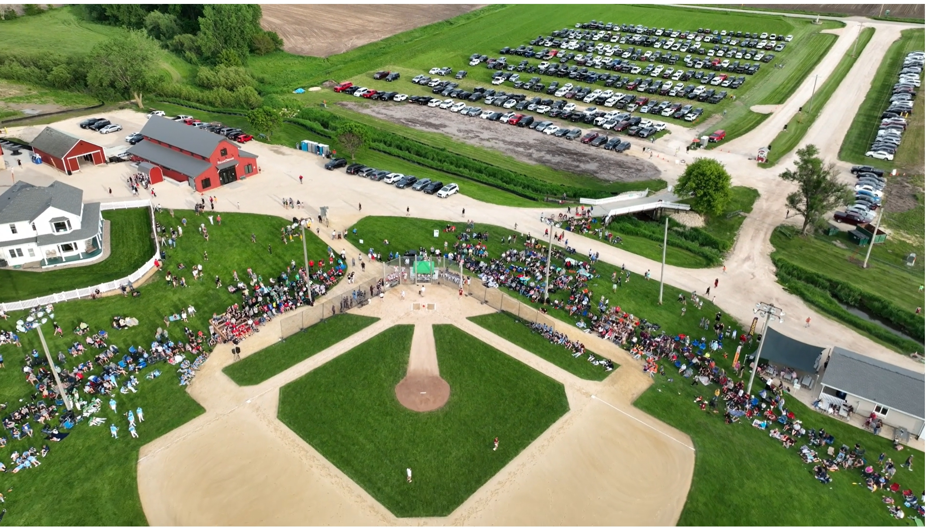
Polling Question #1
Where was the baseball field from the movie Field of Dreams located?
Des Moines
Sioux City
Dyersville

Slide 8
Practical Approach
Keep calm and carry on with the mission
Continue mission-related work while preparing to respond to inquiries
As applicable: remind employees and stakeholders that a response plan exists
When in doubt, contact a lawyer (and have one ready)
Consider your particular risk and appropriate expertise needed
Probably not the lawyer on your Board
Have a plan
Funding, operational, communications, key personnel
Consider your confidential information – is it protected?
Evaluate physical and cyber security
Reach out to other organizations in your sphere of influence – broad interest in nonprofits helping each other

Slide 9
Practical Approach
Lean in to good governance
Keep charitable solicitation registrations current
Consider an independent annual financial audit
Adopt and enforce whistleblower, document retention, and related policies
Clarify board roles and responsibilities
Establish or enhance an independent, professional HR function

Slide 10
Good Governance

Slide 11
Federal Tax Exempt Status
501(c)(3)

Slide 12
501(c)(3)
Organized and operated exclusively for religious, charitable, scientific, testing for public safety, literary, or educational purposes, or to foster national or international amateur sports competition (with limitations), or for the prevention of cruelty to children or animals.
Exclusively Charitable Purposes. A 501(c)(3) organization must be organized and operated exclusively for one or more exempt purposes. Treas. Reg. § 1.501(c)(3) 1(a)(1)

Slide 13
Operational Test of 501(c)(3)
Primarily Charitable Activities. To remain exempt, a 501(c)(3) organization must engage primarily in activities that accomplish exempt purposes. “An organization will not be so regarded if more than an insubstantial part of its activities is not in furtherance of an exempt purpose.” Treas. Reg. § 1.501(c)(3)-1(c)(1).
No substantial non-exempt purpose. To remain exempt, a 501(c)(3) organization must not have a single non-exempt purpose that is substantial in nature, regardless of the number or importance of other charitable activities. Better Business Bureau v. United States, 326 U.S. 279 (1945).

Slide 14
Organizational Test of 501(c)(3)
Governing documents limit purposes to exempt purposes, and do limit activities to those in furtherance of exempt purposes.
Assets permanently dedicated to an exempt purpose (including dissolution clause).

Slide 15
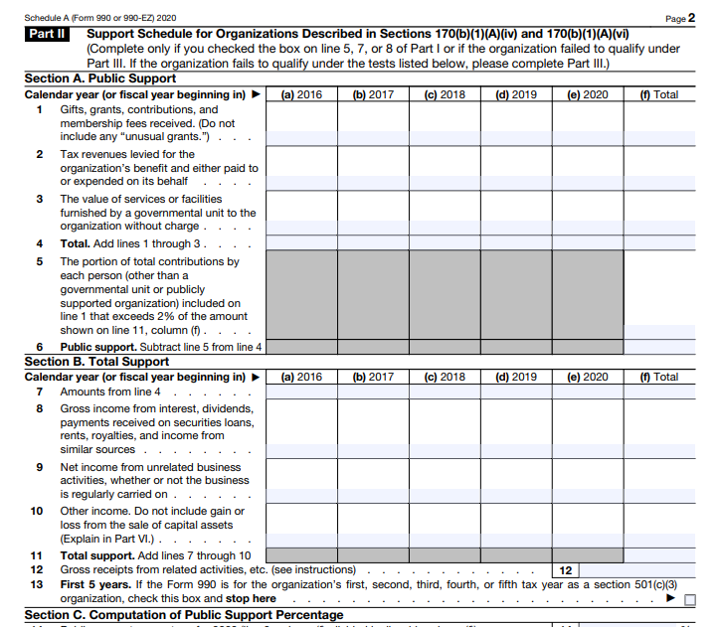
Public Charity vs. Private Foundation
Public Charity Status
Public support test (1/3 from public sources)
Also, educational and religious organizations
Favorable tax treatment
Private Foundation Status
Typically funded by single source
Minimum annual distributions
Investment tax
Stricter regulations

Slide 16
Public Charity Status
170(b)(1)(A) – includes churches, educational organizations, hospitals and similar, publicly supported organizations, supporting organizations

Slide 17
Understanding Governance
Certificate of Formation, Bylaws, and Governance Policies
Texas Business Organizations Code
Role of the Board of Directors
Duty of Care
Duty of Loyalty
Duty of Confidentiality
Duty of Obedience
Meeting and recordkeeping

Slide 18
Governance Policies
Conflict of Interest Policy
Whistleblower Policy
Document Retention Policy
Accountable Reimbursement Policy
Gift Acceptance Policy
Financial Procedures Policy
Endowment and Spending Policies
Investment Policy
Code of Conduct and Ethics
Fundraising Policy
Compensation Policy
External Communications and Social Media Policy
Foreign Activities and/or Grantmaking Policies
HR Policies

Slide 19
Governance and Board Accountability
Directors’ & Officers’ (D&O) Insurance
Ensure defense‑cost coverage and appropriate limits
Review exclusions, retentions, endorsements
Align coverage with regulatory investigation risks
Conflict‑of‑Interest & Compensation Policies
Document reasonableness of salaries and related‑party transactions
Reduce exposure to intermediate sanctions and AG scrutiny
Strengthening Governance Documents
Audit Bylaws, mission, and operational policies for §501(c)(3) alignment
Avoid private benefit and ensure fiduciary duty compliance
Board Best Practices
Adopt governance policies
Conduct regular board evaluation
New Board member orientation
Annual Board training

Slide 20
Polling Question #2
The State of Iowa is known for growing:
Potatoes
Corn
Oranges

Slide 21
Federal Exemption Compliance
Maintaining 501(c)(3) Status
Operational and organizational tests
Annual Form 990 filings
Auto-revocation if not filed for three years
Churches and certain religious organizations are exempt
Ministries/nonprofits under a church group exemption are not exempt
Unrelated Business Taxable Income (UBTI) and Form 990-T
Churches are not exempt
Public Information Disclosure Requirements

Slide 22
Federal Exemption Compliance
IRS Oversight and Regulation
Insiders / Disqualified Persons
Intermediate sanctions / Excess Benefits
Self-Dealing / Prohibited Activities / Excise Taxes
Private Inurement
Private Benefit
Substantiating Donor Contributions

Slide 23
Texas Compliance
Periodic Reports with Secretary of State
Franchise / Margin Tax Exemption
Sales Tax Exemption for Items Purchased
Sales Tax for Items Sold – Generally Not Available
Property Tax Exemptions
Hotel Occupancy Tax, Motor Vehicle Tax
Disclosure Requirements

Slide 24
Common Compliance Challenges
Unrelated Business Taxable Income (UBTI)
Failure to identify
Misunderstood as exempt from Form 990-T
Poor Recordkeeping
Uniform Prudent Management of Institutional Funds Act (UPMIFA)
Governance Failures
Board meetings, membership documentation, internal controls, conflicts of interest, inadequate documentation of actions, improperly amended documents
Registered Office and Registered Agent
Required by Texas Business Organizations Code
Keep updated with Secretary of State’s Office
Gambling, Raffles, and Casino Nights

Slide 25
Polling Question #3
In 1892, Andrew Carnegie funded construction of the first “Carnegie Library” in the United States that was outside of Pennsylvania. That library was located in:
Dallas, TX
Fairfield, IA
Chicago, IL

Slide 26
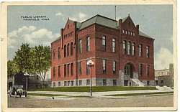
Polling Question #3
In 1892, Andrew Carnegie funded construction of the first “Carnegie Library” in the United States that was outside of Pennsylvania. That library was located in:
Dallas, TX
Fairfield, IA
Chicago, IL

Slide 27
Key Takeaways
Staying Compliant and Mission Focused

Slide 28
Keep Calm
Compliance is an ongoing process
Good governance is critical to the mission
Understand state and federal requirements
Review and revise policies and procedures regularly

Slide 29
Questions and Answers
Genevra M. Williams
genevra@mendrygallaw.com
www.mendrygallaw.com

