Slide 1
Working Remotely
2021 UFLC Conference
By Patti Malott

Slide 2
Remote World – Yesterday and Today
Old idea with failures
IBM, Bank of America, AT&T, Aetna and Yahoo attempted it
IBM was 40% remote in 2009, called thousands back in 2017
March 2020 – Unprecedented shift
Companies have extended WFH orders indefinitely
Zillow, Visa, Nationwide, Google, Twitter, Facebook, Shopify, Square
74% of CEOs expect some permanent shift

Slide 3
Remote Work Experience
Prior to COVID-19 (data on server, analog phones, cloud-based programs)
During COVID-19
Hired personnel remotely
Onboarded personnel remotely
Trained personnel remotely
Staff meetings remotely
Performance coaching remotely
Currently
Hybrid remote/office staff
Fully prepared for emergencies

Slide 4
Agenda
Pros and Cons of Working Remotely
Qualifications of Remote Workers
Hiring Remote Workers
Onboarding Remote Workers
Managing Remote Workers
The Right Strategies in Place

Slide 5
Working Remotely-What Others Have Said
Pros
Cons
Less travel
Less gasoline
Less stress in traffic
Flexible hours
Casual dress
No makeup
Distractions
Lack of tools
Feelings of isolation
Miss out on “water-cooler” updates
Lack of information
Lack of synergy

Slide 6
Qualifications of Remote Workers
Getting the Right Person on the Bus

Slide 7
Must Have Qualities of Successful Remote Workers
Trustworthy
They deliver on time, every time
Attend every meeting on time
Never a question that they are working
Problem Solvers
Good at identifying problems and seeking solutions on their own
Know when to bring others into the mix

Slide 8
Must Have Qualities of Successful Remote Workers
Self-Motivated/Results-Driven
Do tasks because they are interested in the project and committed to the outcome
Superstar Communicators
Stellar written and spoken communication skills to help bridge the gap
Understand that communicating remotely takes extra effort

Slide 9
Additional Valuable Qualities
Proactive
Adaptable
Collaborative
Customer-focused

Slide 10
Hiring Remote Workers
Getting the Right Person on the Bus

Slide 11
Recruiting Virtual Team Members
What would motivate someone to apply?
Eliminating stressful commutes
Spending less money on food, gas and clothing
Work-life balance
More time for self-care
Flex time?
Post wisely-brief overview, teaser, call to action
Post legally
Don’t use words like young, single or healthy
Use words like vibrant, interactive or self-directed

Slide 12
The Job Description
Report to
Title
Status (exempt/non-exempt)
Classification (full or part-time)
Purpose (mission statement)
Duties & Responsibilities
Skills & Education
Working Conditions
Organizational Relationship
Special Requirements
Last line: This job description is not all-inclusive and may be modified verbally or in writing by my supervisor.
Signed and dated by the new hire

Slide 13
Compensation & Benefits
What will the position really cost?
Salary
Benefits
Workers’ Comp Insurance
Tools and technology
Training
Salary surveys for comparisons (COVID changes)
Know what you are willing to negotiate before the interview

Slide 14
Preparing for a Virtual Interview
Review application or resume for red flags
Gaps in employment
Short employment stays
Frequent geographic moves
Highlight successes documented on resume
Achieved by working independently
Achieved by working as a team
Last promotion
Prepare list of questions to ask
Know how to rephrase a question to interview legally
Arrange for someone to interview with you

Slide 15
Preparing for a Virtual Interview
Let the applicant know someone will be with you during the interview
Ask the candidate to share in writing why they should be hired for the position
Ask the candidate to video themselves as they share why they should be hired and what is important for you to know about them
Ask the candidate to address a scenario
(Their new place of employment is sending them to an island for three months with no contact with the team. They are allowed one page to share what they feel is important for the team to know during their absence.)

Slide 16
First Interview
One questions while another watches body language
Ask questions that reveal their strengths and skills
If money were not an issue, what would you be doing today?
What are the most satisfying accomplishments of your career?
Share your biggest failure and what you learned from it
What gifts do you have that other team members might need to balance?
What gifts or strengths would you need from others?
Rate their responses
More questions available if requested

Slide 17
Second Interview
Clarify expectations
Learn more about their exact roles in previous positions
Ask more behavioral questions
Discuss your Code of Ethics/Values
Let candidate know you will be checking references
Provide a Release of Liability form to sign, giving permission to contact references without legal ramifications
Have them complete Background Authorization form

Slide 18
Checking References
Spend adequate time on this—especially with remote employees
Real conversation with previous employers
Inform previous employer that candidate has applied for position and has signed a release form giving them full rights to disclose information without legal liability.
If applicant has served in remote capacity in previous job, ask specific questions regarding their communication skills and ability to:
Solve problems on their own
Complete assignments on schedule
Work effectively with others—remotely and in person

Slide 19
Make the Offer
Provide offer in writing
Send letter and follow-up with remote session to cover any questions
Don’t make any future promises
Keep it simple and be crystal clear
Refrain from annual salary amounts
Indicate what employee would make per pay period and what that would be if they worked for 12 consecutive months
Example:

Slide 20
Make the Offer
Benefits:
According to Plan Documents
Example
Based upon available funding
Example
Personnel Policy
Include same statements regarding Plan Documents or funding
Background check before employee starts

Slide 21
Onboarding Remote Employees
A Different Kind of Experience

Slide 22
Connect the Team
Be creative and make a lasting first impression
Provide virtual tour through the office
Introduce them to each employee as you go
If team is entirely remote, virtual introductions
Provide “fun facts” to help relate
Ask team members to reach out to welcome others (notecard, phone call)

Slide 23
Provide Resources
Plan ahead
Tools ready to go
Laptops/computers
Phones
Webcams
Monitors
Arrangements for advance shipment – if needed
Set up email and other logins
Policies & Processes sent in advance to review
List of employees and contact info

Slide 24
Schedule Meeting with HR
Remote meeting if onsite is not possible
Complete New Hire Paperwork
Discuss Policies & Processes
Links to key resources
Bios of team members
Organizational chart with pictures (airplane)
Forms requiring signatures can be signed while in view, scanned and sent back to HR

Slide 25
Discussion with HR
How the remote employee will check in
When they need to be accessible
Schedule requirements
How they will track their time
What software they will use
How task progress is tracked
How and when they will be paid
How other team members can support them

Slide 26
Managing Remote Workers
Defining a Healthy Culture
Notes:
Same

Slide 27
Culture Trumps Strategy Peter Drucker
Values and beliefs must guide our goals and plans.

Slide 28
Trust
Regardless of position, employees have and feel the freedom to speak up, ask questions, debate and be vulnerable.
The leader doesn’t have all the answers.

Slide 29
Clarity in Expectations
Line of sight needs to be so clear that everyone understands how their role connects with others.

Slide 30
Accountability
Leaders must be willing to confront behavior and performance.
Leaders need to be held accountable and model that standard to the team.
Notes:
During staff meetings

Slide 31
Core Values
How is the game played?
What are the rules?
What does a win look like?
Am I on a team or on my own?

Slide 32
Results
What does a win look like for the employee personally?
What are the goals of the team?
How will the results be communicated?
Who will communicate the results and when?

Slide 33
Focus on Communication
Communication is key when leading remote teams
Make sure you have the right communication tools
Emails, texts or chats can be misinterpreted
Use visual as much as possible

Slide 34
Clarify Communication Methods for Urgent Matters
How will your staff communicate?
Some live by texts on their phone, while others like a phone call
Clarify how employees should contact you in urgent matters
Be sure to respond
Zoom calls - live

Slide 35
Schedule Regular Check-In Times
Remote employees can’t stop by your desk when they need an answer
Be sensitive to extroverted and introverted team members

Slide 36
Daily Virtual Check-ins
15-20 minutes max
Microsoft Teams - Allows team members to view what others are working on
4 things to ask:
What is on their plates?
Where are they stuck?
Are they on target?
What do they need from me?
End of day dashboards/Team status

Slide 37
Weekly One-on-One
Minimum 30 minutes
80% listening, 20% talking
What is going well for them?
What are some challenges?
Ask, “How can I serve you better?”

Slide 38
Value Relationships
High Tech, High Touch
Physical distancing, not social distancing
In remote work, relationships are just as important as the tasks to be completed

Slide 39
Make it Personable
Ask about family, hobbies or weekend
“Tell me how you’re doing”
“Tell me how you’re really doing”

Slide 40
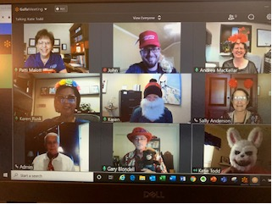
Use Humor
A great way to add fun at the start or throughout the day
Much like singing, it is universal in bringing people together

Slide 41
Track Work, Not Time
Tracking work and not hours can be much more productive and cohesive

Slide 42
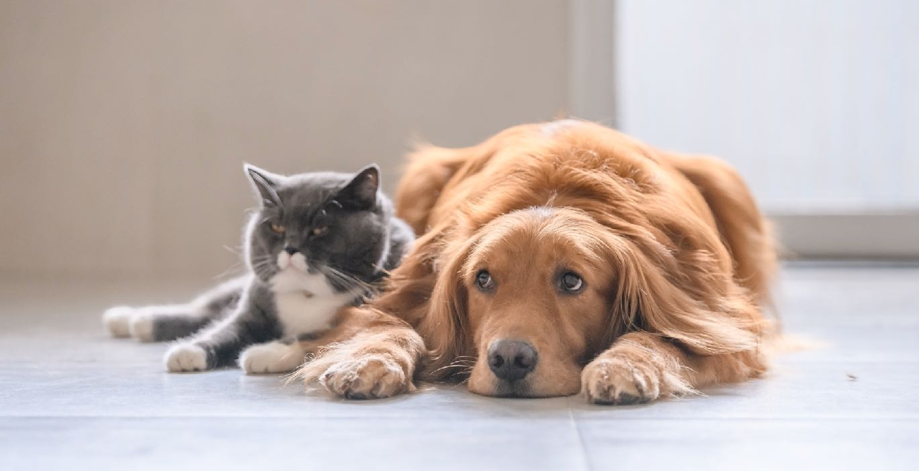
Work Productively

Slide 43
The Right Strategies in Place
Managing What You Can’t See

Slide 44
Set Clear Expectations
1
2
3
4
Show
Show the employee the method currently used
Show
Show what the desired result is to look like
Give
Give them the flexibility to change the process
Give
Give them some space to be successful

Slide 45
Set Goals and Celebrate Milestones
Identify outcome
Set short- and long-term goals and milestones
Celebrate wins along the way
Emails or notes of encouragement
Recognition at staff meetings
Afternoon off upon completion
Praise early, often and publicly
Ways to celebrate

Slide 46
Monitor Progress
Don’t wait until work is completed to review it
Set regular appointments to review progress together
Are there unexpected challenges?
Does the employee need help in setting priorities?
Is the work on schedule?

Slide 47
Assess the Project and Process When Completed
Discuss the following:
What went well?
What could we have done differently for a better outcome next time?
What could we share with other team members about this project that could help them on a future project?
How did the completion of the project benefit the organization?

Slide 48
Tips for Working Remotely Effectively and Professionally
Start well
Take breaks
Block out time wasters
Set boundaries
Shift gears, close up shop, and detach

Slide 49
In Summary
Working remotely requires extra effort on
the part of both supervisors and employees. It takes time to settle into a routine that supports a happy, productive team.
When employees are successful, the organization reaps the benefits, and it is a win-win for all.
Culture starts at the top
You can only manage what you measure

Slide 50
Policies & Agreements
Work From Home Agreement
Position Description Addendum
Remote Personnel Policy
Confidentiality Policy
Conflict of Interest Policy

Slide 51
Collaborative Platforms
GoToMeeting
Zoom
WebEx
Teams
Basecamp
Trello
Slack
Clockwise
Monday.com
Asana

Slide 52
Patti Malott
CO+OP
9950 Cypresswood Dr., Ste. 250
Houston, Texas 77070
832-478-5131 office
281-797-8619 cell
patti@churchco-op.org
patti@texasministryconference.org

